Slide 1
Spotify Data Analysis
Deepika, Maria, Tanner

Slide 2

Summary
Artist popularity
Genre
Audio Features
Total Songs released in a Year
Findings

Slide 3
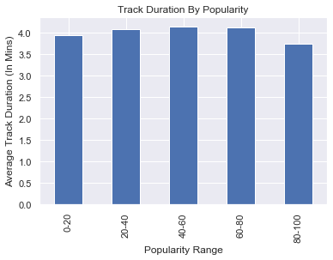
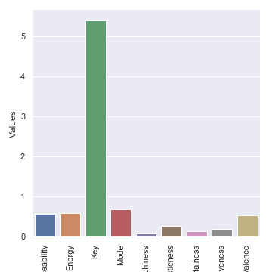
Data Analysis
Track Duration Analysis

Slide 4
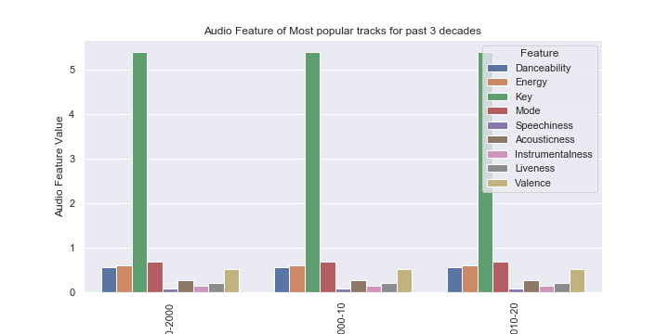
Data Analysis
Audio Features analysis

Slide 5
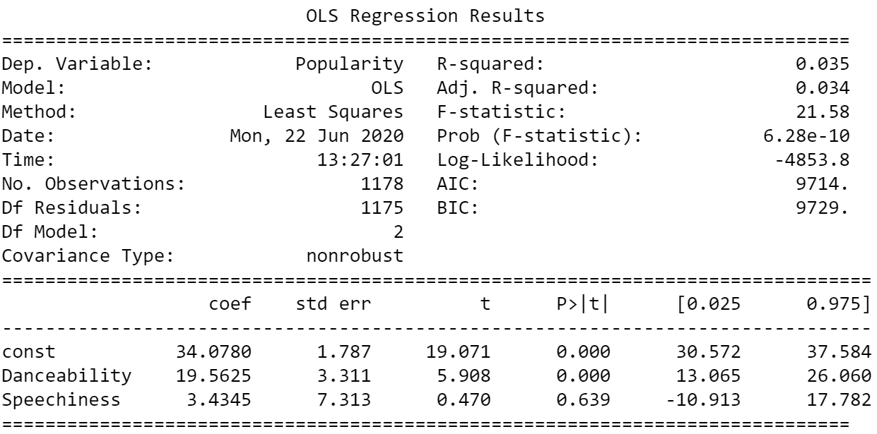
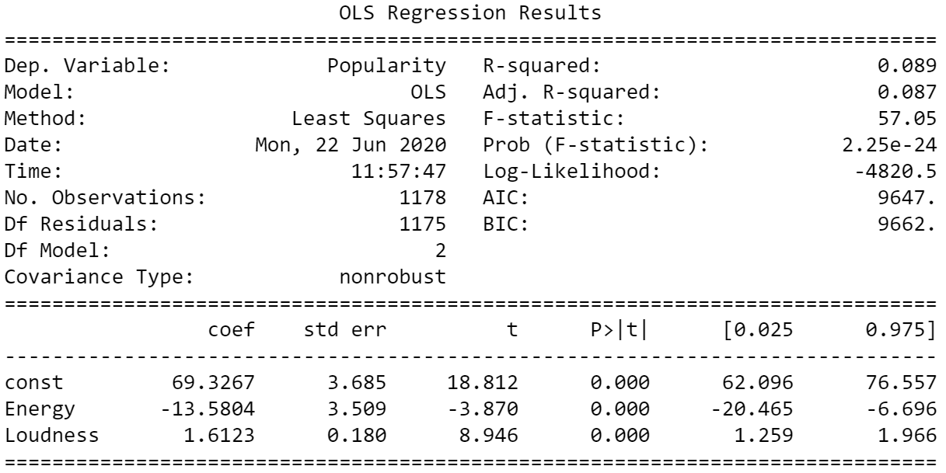
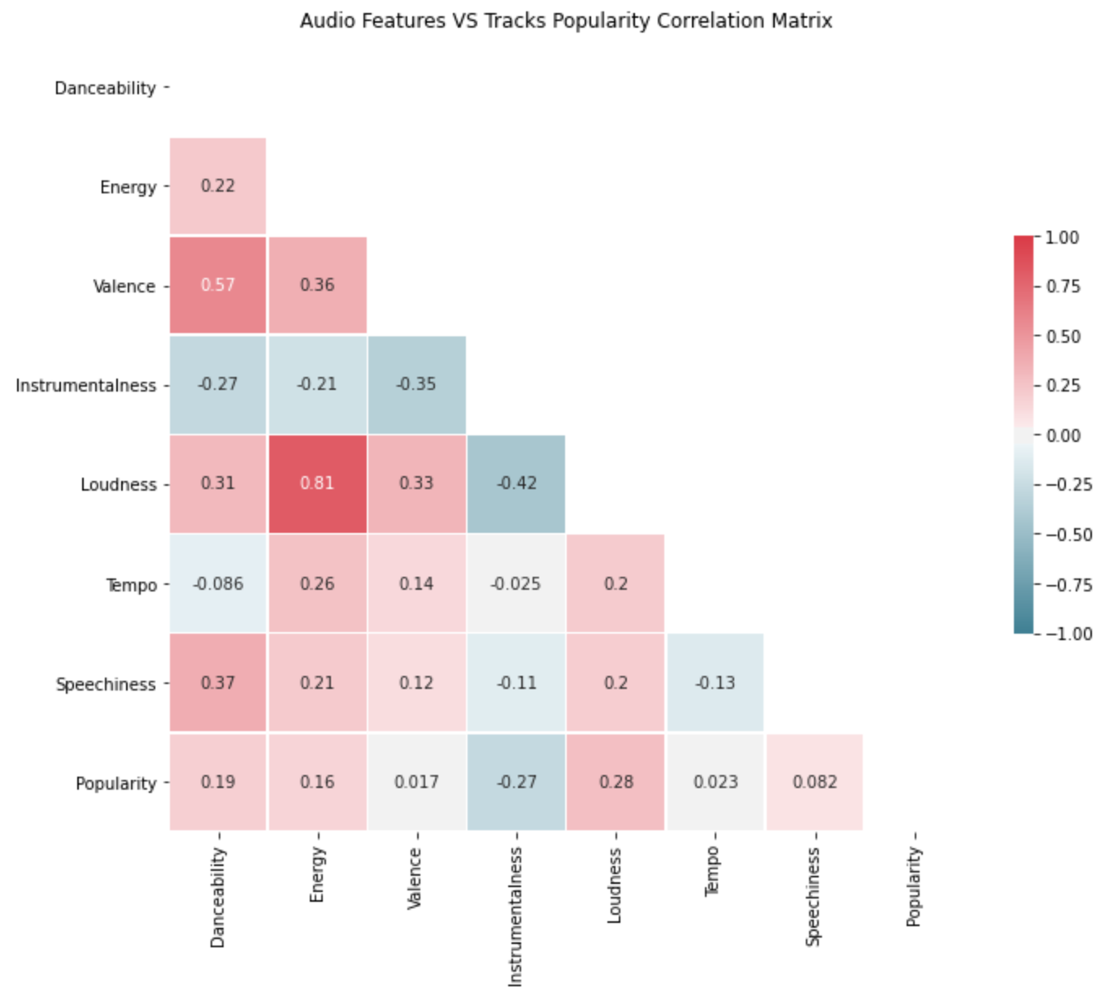
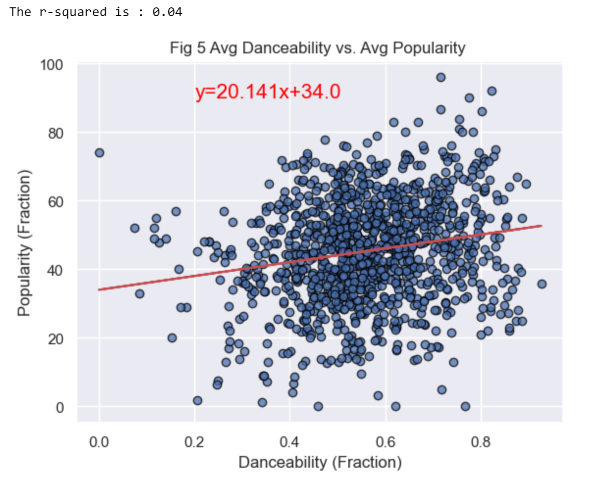
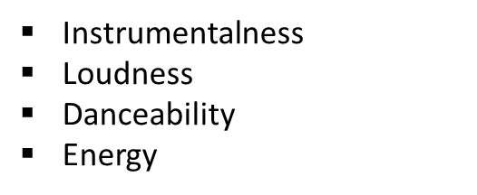

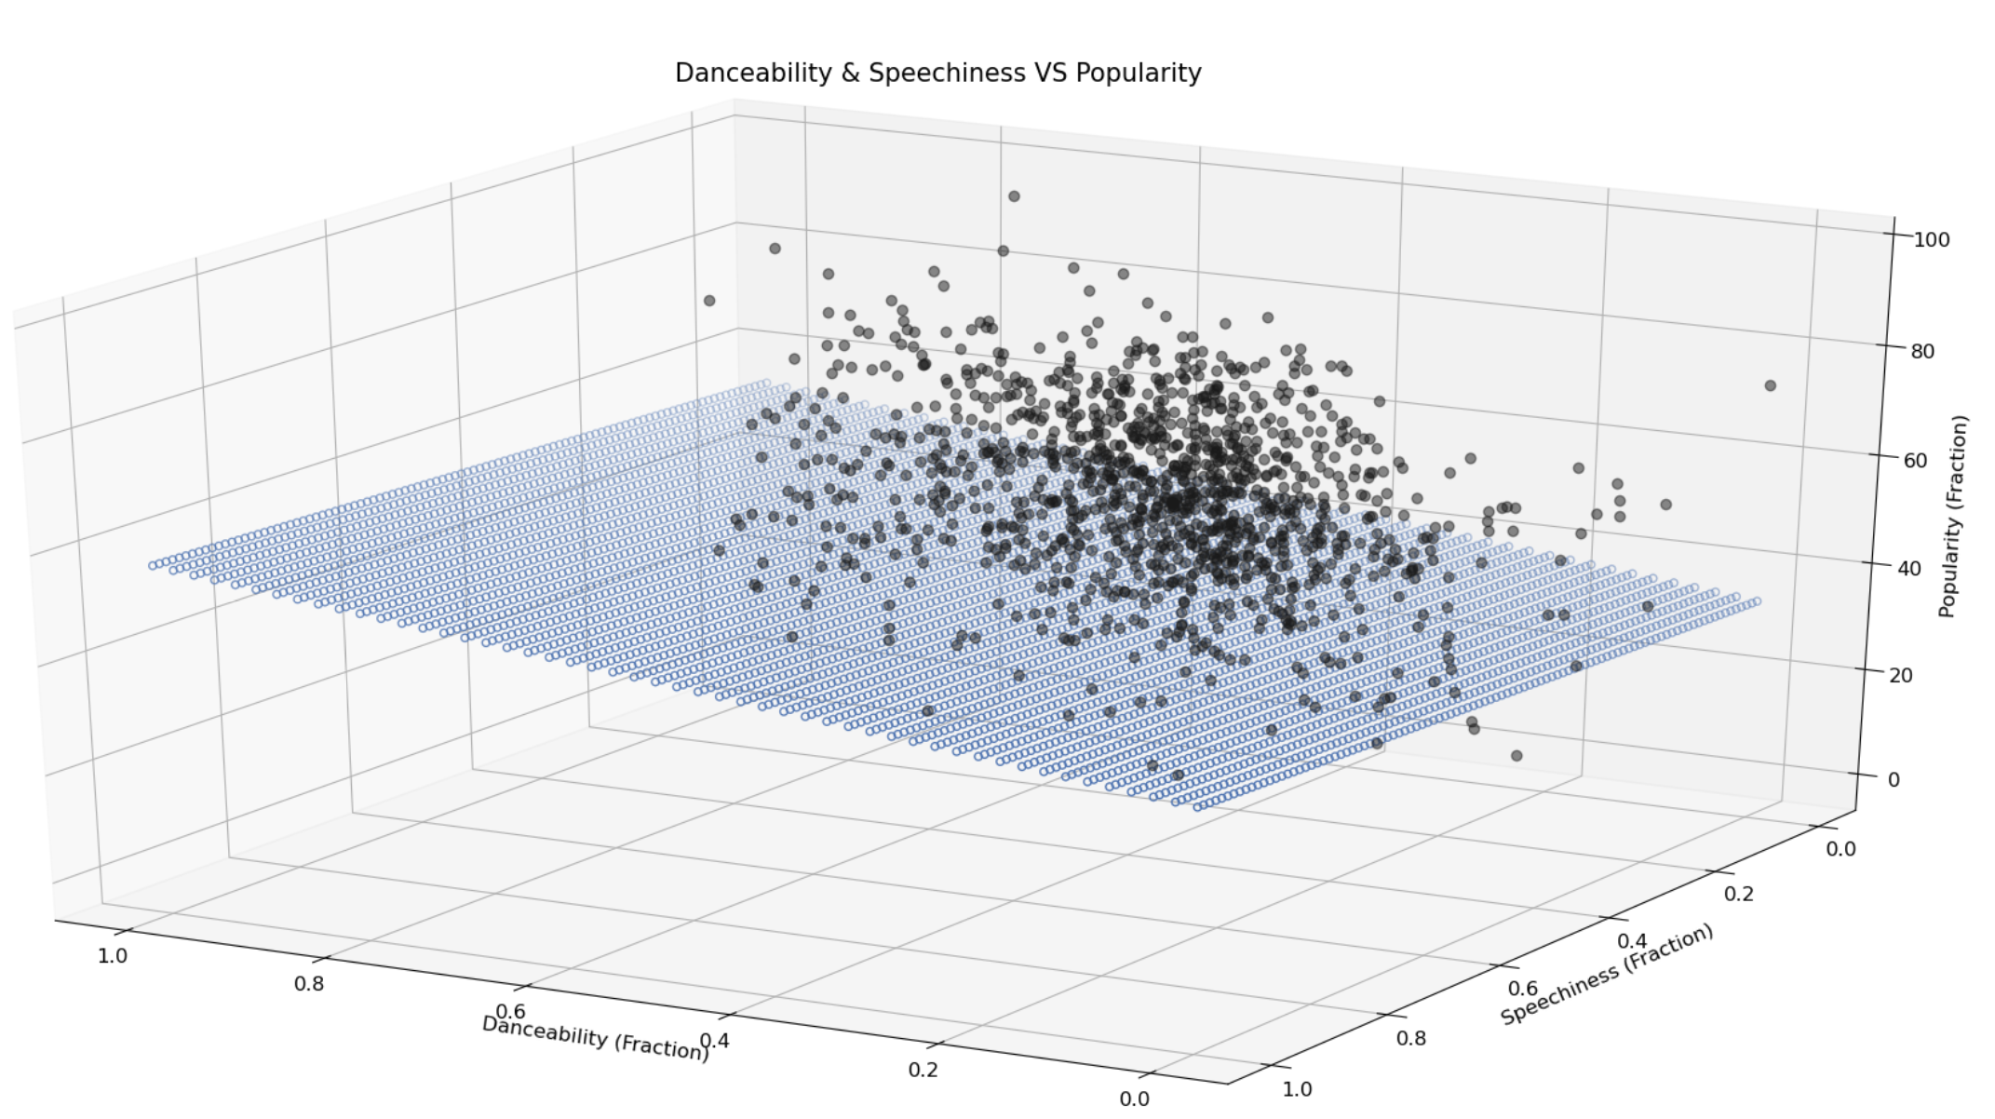
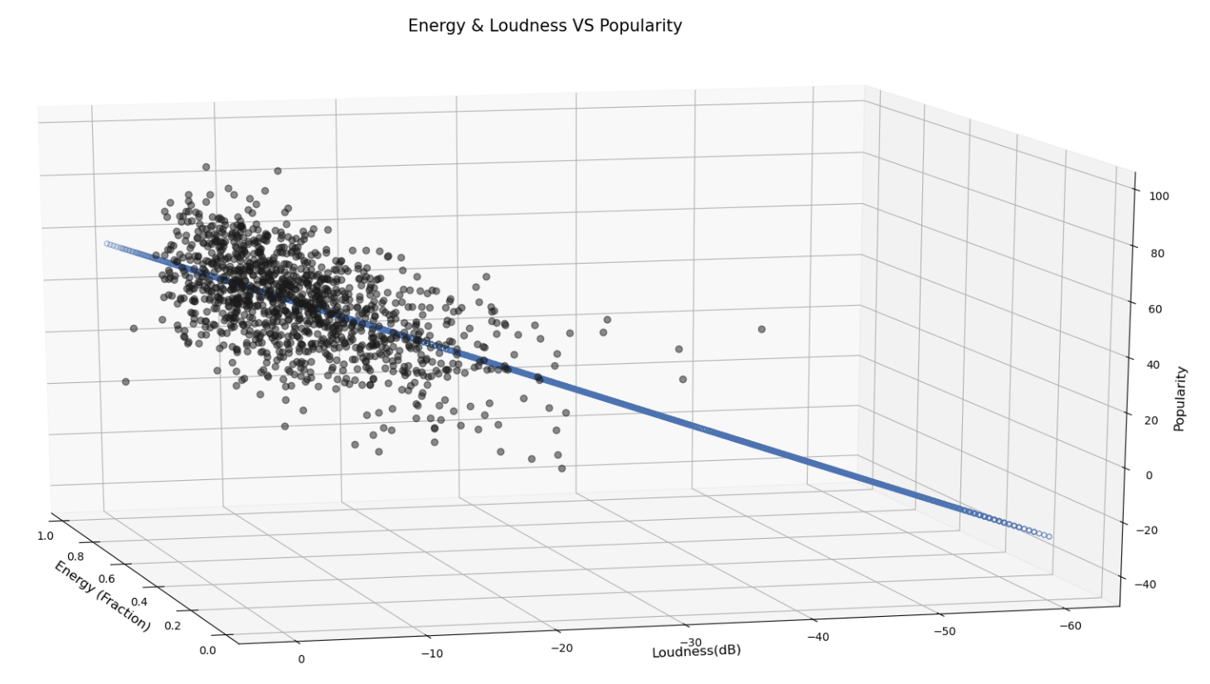
Data Analysis
Does Tracks Features (danceability, energy…) affect songs popularity? Any relationship?
Multiple Linear Regression
Source: An Introduction to Statistical Learning, James G., Witten D., Hastie., Tibshirani R.

Slide 6
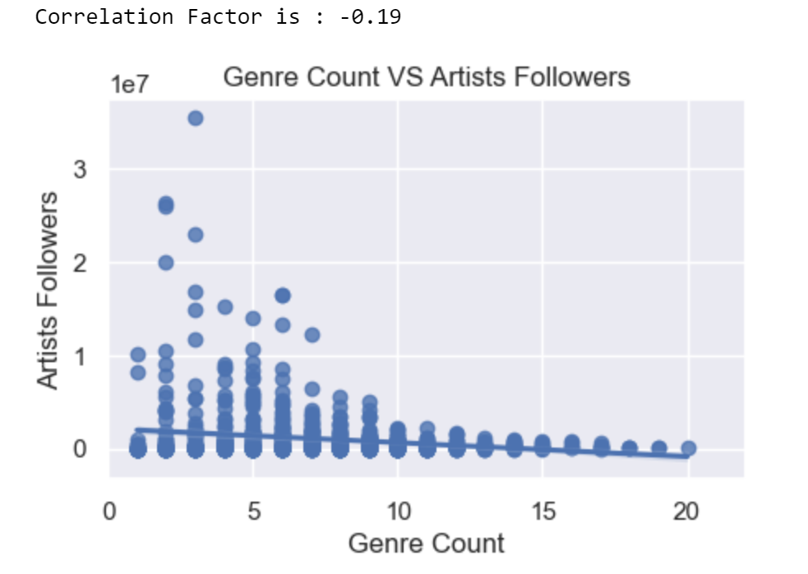
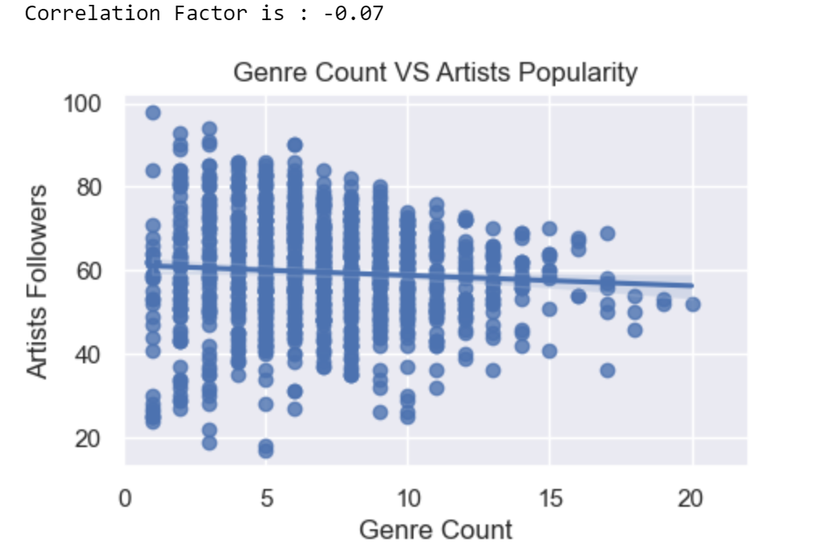
Data Analysis
The higher Genre Count per artist, the higher Artist Popularity and Artist Followers?

Slide 7
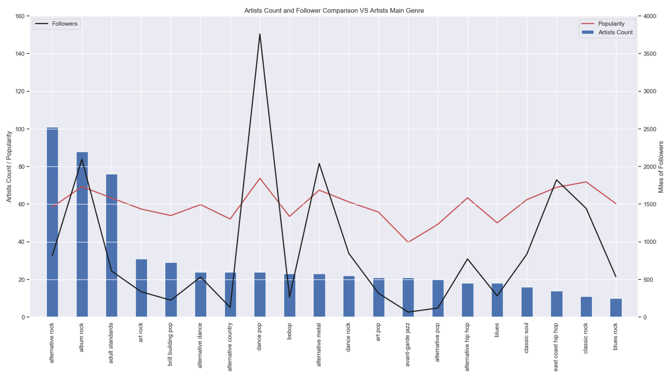
Data Analysis
Main Genre per Artist and the relationship with their Popularity and Followers

Slide 8
Discussion
Track Duration Analysis
XYZ

Slide 9
Post Mortem
Discuss any difficulties that arose, and how you dealt with them
Discuss any additional questions that came up, but which you didn't have time to answer: What would you research next, if you had two more weeks?
Group A
Task 1
Task 2
Group B
Task 1
Task 2
Group C
Task 1
Task 2
Group D
Task 1
Task 2

